Slide 1

UCSF Staff Engagement Survey
Notes:
Why should I participate in the Engagement Survey? Sharing your thoughts about your work helps drive real change. It is one of the best ways we have to voice our opinions confidentially with the goal of improving our own work lives, those of our colleagues, and UCSF overall. Please take the survey, share the poster online or by printing and posting it onsite, and remind colleagues to participate.

Slide 2
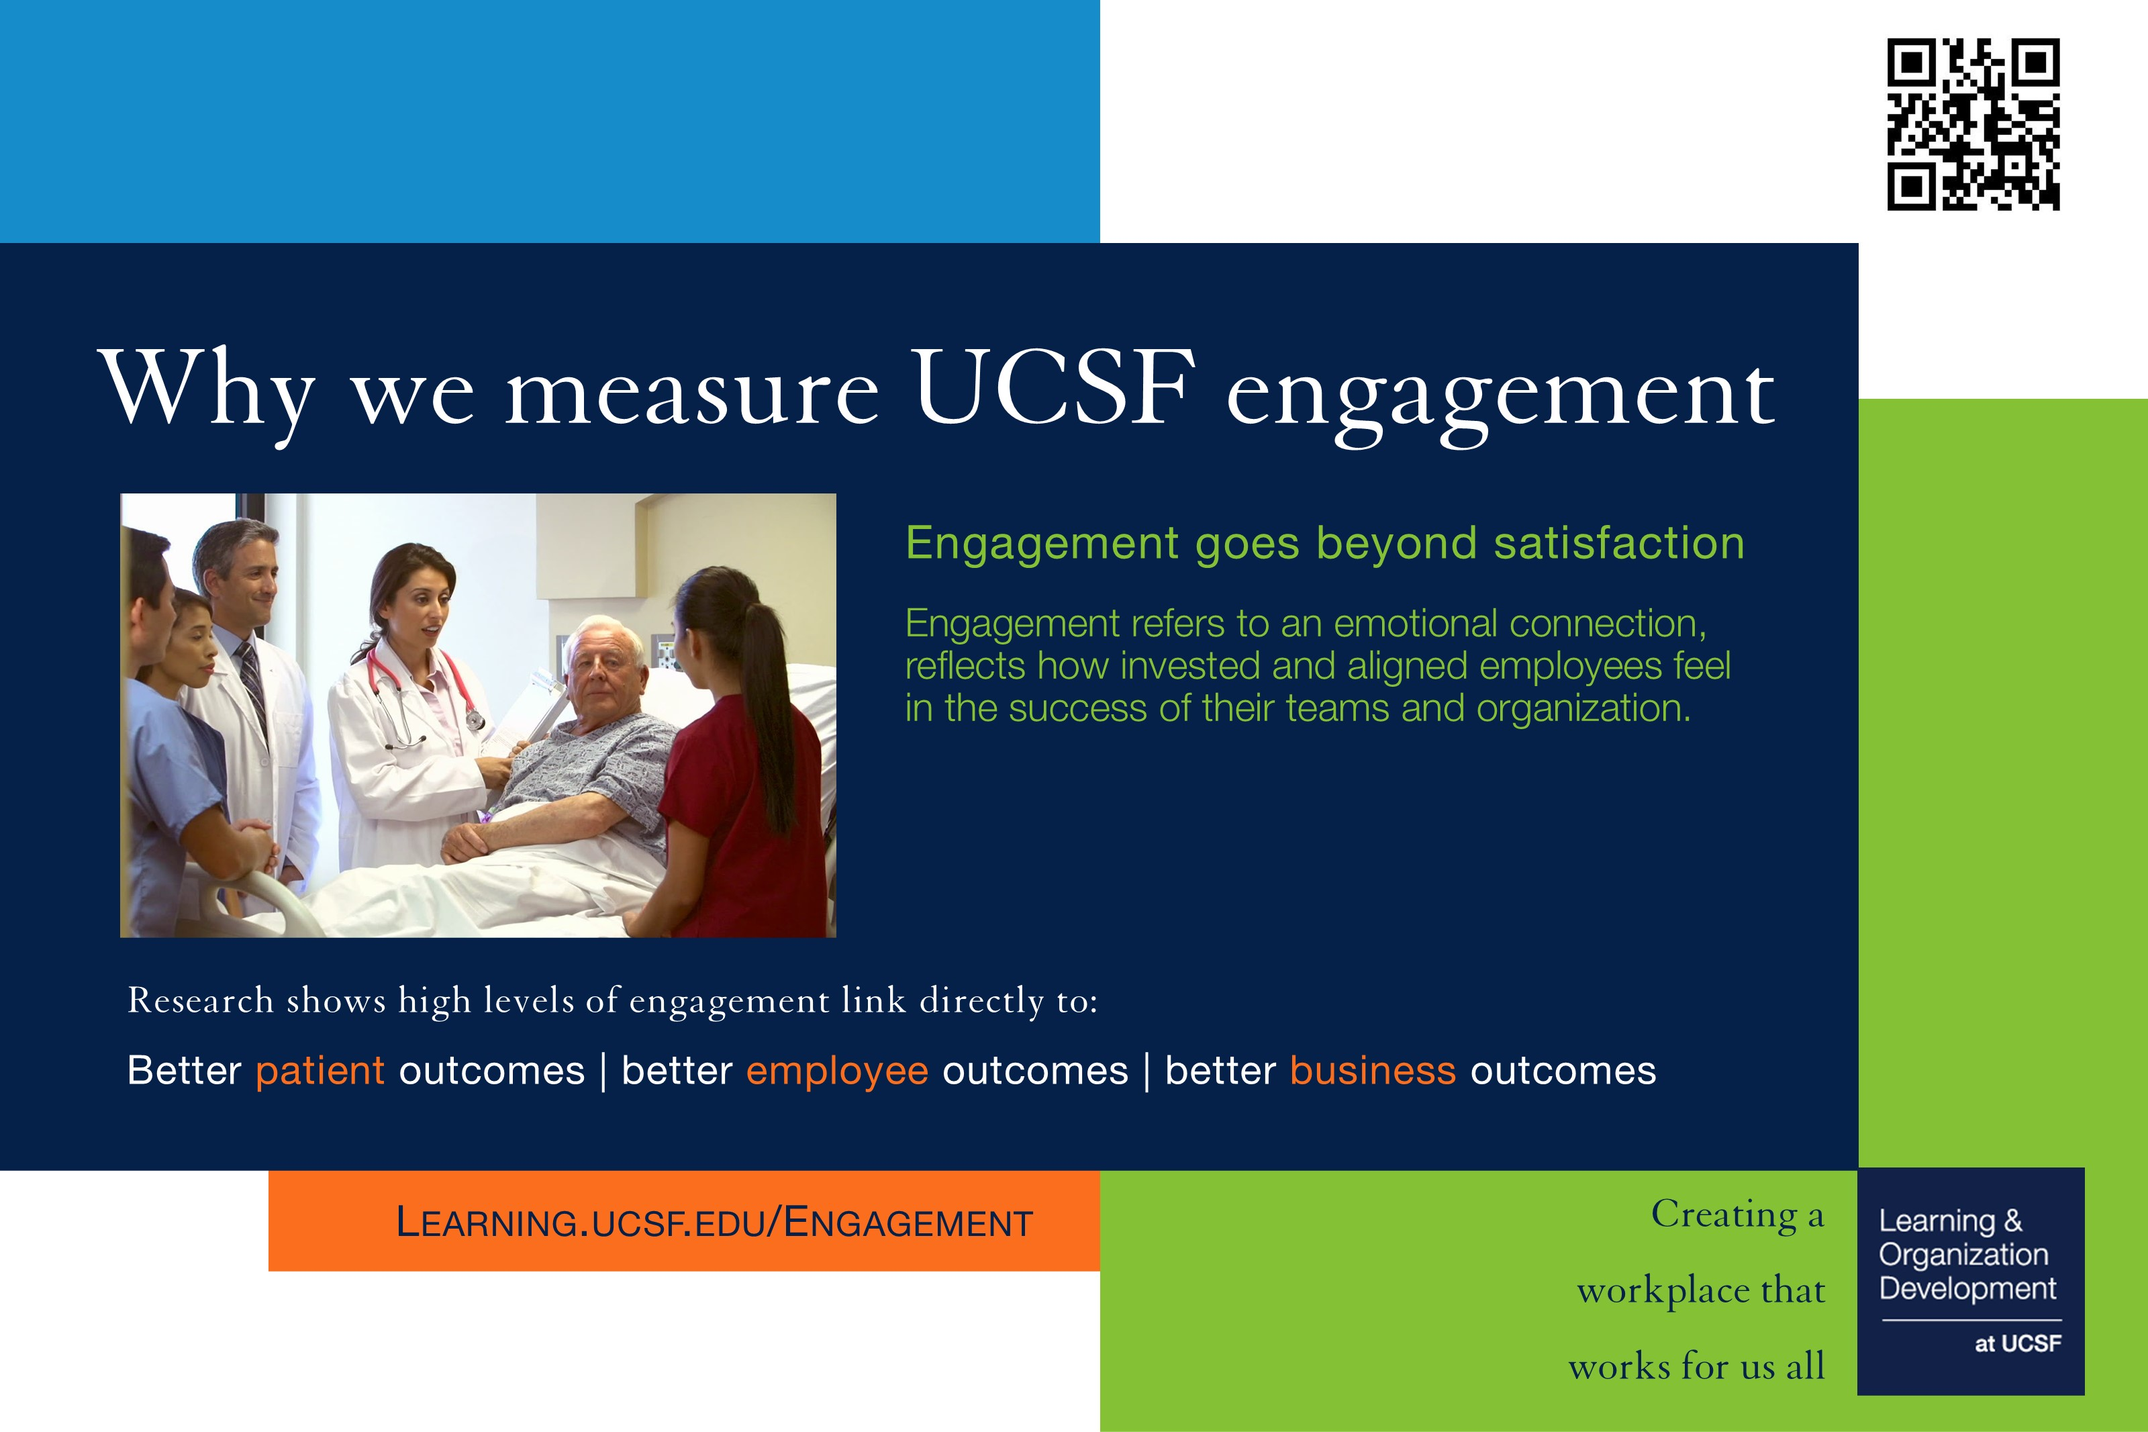
Why we measure UCSF engagement
Notes:
Why is staff engagement important? Research conducted by international polling experts at Gallup Inc. shows that high levels of employee engagement link directly to positive patient, business, and employee outcomes. With years of responses collected at UCSF, we have meaningful data to guide our work. This goes beyond job satisfaction: engaged employees have opportunities to do what they do best every day and they feel a sense of belonging at work.

Slide 3
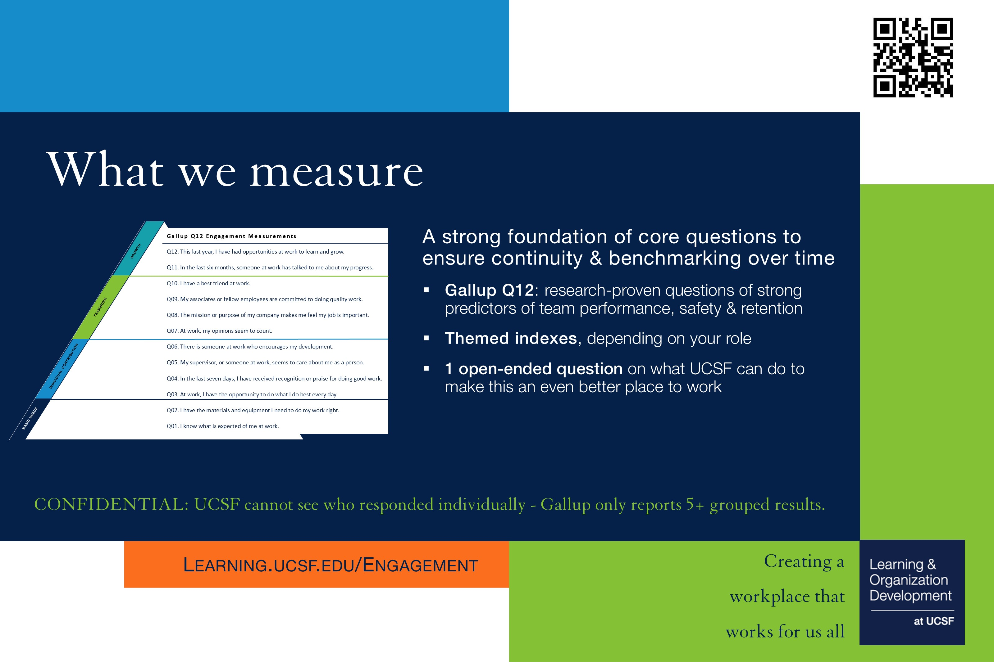
What we measure
Notes:
Internationally-renowned research has identified 12 questions about engagement that indicate a high-performing work environment, known as Gallup’s“Q12.”
At UCSF, we review organization-wide results for indexes such as Accountability and Belonging; some areas also examine additional indexes based on their scope of work, such as select Patient Experience and Patient Safety indexes; and we regularly ask our Net Promoter (would you recommend UCSF as a place to work and get care?”) as well as Open-Ended question on what we can do to make UCSF a better place to work.
Particular wording is used, such as “I have a best friend at work,” because research shows that the specific language reveals qualities that differentiate teams on critical outcomes such as productivity, safety and retention.
Confidentiality is Assured. UCSF contracts with the renowned independent research organization Gallup Inc. to collect survey responses. Gallup NEVER shares individual responses. UCSF doesn’t have access to know who specifically takes the survey and cannot track what their individual responses are. Additionally, no survey data reporting is shared with UCSF unless there are 5 or more respondents.

Slide 4

Enhancements
Notes:
For 2026 enhancements:
We continue to evolve the survey based on staff feedback
Made minor tweaks to add questions looking at how we collaborate across teams, and
Added a leader index to better understand how teams experience leadership at the local level
[Internal note: Magnet RN inquiries (Patient) are not being asked this year, as they are asked every other year]

Slide 5

Engagement website has the latest
Notes:
Our engagement website features all the latest information on UCSF engagement, including: important dates, survey measures, participation rates, FAQs; survey poster, slide, and Zoom background; action planning an strengths guidance; Ambassador and Manager resources.
For Managers, highlight that:
Survey results will be released on May 13 this year
Survey office hours are available throughout the survey open period
Manager email template on website helps you craft your personalized leader message to encourage staff to be heard by participating in the survey!

Slide 6

UCSF Staff Engagement Survey - How
Notes:
To share once the survey is open, but not before (FYI the survey links will not be live unless the survey is open)
Take our brief, annual, voluntary survey that provides an opportunity for us to identify our strengths and improvement areas as a workplace, towards improving our own work lives, those of our colleagues and UCSF overall.
UCSF staff are invited: including UCSF Campus, Health, Hyde and Stanyan Hospitals, UBCP, Benioff Children’s Hospitals - SF & Oakland - who were on payroll as of early January 2026 (with a few exceptions for short-term and part-time staff).
Gallup emails the survey link directly to staff and sends reminder emails.
Those emails are scheduled for the survey opening date, plus several reminders throughout the survey open period and on the last day of the survey if you have not yet taken it. Alternatively, staff can log into Gallup Access (with MyAccess) or Gallup 2026 Survey (with UCSF Employee ID minus the first “0”) to take the survey only while the survey is open.
Everyone’s voice counts; we want to hear from all staff. UCSF takes these survey results seriously across the organization. We can only interpret results from staff who participate.

