Slide 1

Strength 1
Strength 2
Strength 3
Strength 4
Strength 5

Slide 2

Strength 1
Strength 2
Strength 3
Strength 4
Strength 5

Slide 3

Strength 1
Strength 2
Strength 3
Strength 4
Strength 5

Slide 4

Strength 1
Strength 2
Strength 3
Strength 4
Strength 5

Slide 5
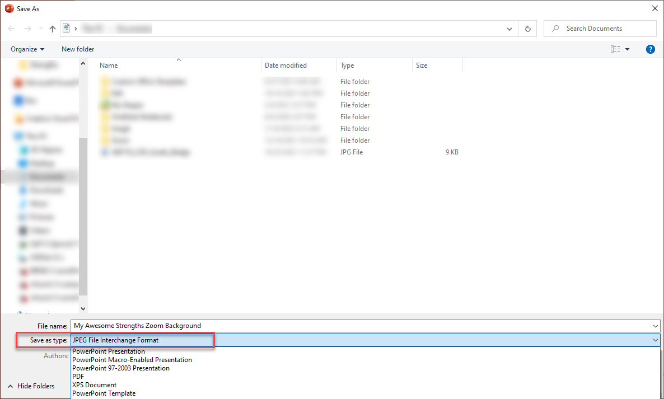
To create a Zoom background
Replace slide text “Strength 1-5” with your Top 5 strengths
as listed in Gallup Access under “Your CliftonStrengths”
Save the PowerPoint file as “JPEG” file type
Upload the created JPEG file to
your Zoom Virtual Background

